Slide 1
Max Meiners
214936

Slide 2
Table of Contents
List of Themes
Theme
AI canvas
EDA Results

Slide 3
Public Nuisance
How can the municipality accurately predict and allocate the necessary number of BOAs to prevent public nuisance in Breda?
To maintain its appeal for a diverse population, Breda must address and minimize public nuisance. However, the municipality faces difficulties in defining public nuisance, understanding its impact on quality of life, and attracting new residents. Furthermore, accurately predicting the necessary number of BOAs (enforcement officers) to prevent public nuisance is a crucial challenge for the municipality.
Identifying the necessary number of BOAs for preventing public nuisance allows for proactive measures rather than reactive responses. This research question is important for individuals and organizations interested in preventing public nuisance incidents before they occur and taking pre-emptive actions to maintain order and harmony in Breda.

Slide 4
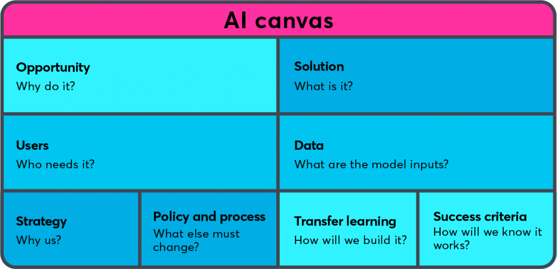
AI Canvas: Help explore solutions & ideas
How can the municipality accurately predict and allocate the necessary number of BOAs to prevent public nuisance in Breda?
Develop predictive models
Municipality of Breda
Data.politie.nl
Opendata.cbs.nl
Predictive model
SKIP THIS PART
Precision, recall and F1-score
Policy alignment, legal and ethical considerations​

Slide 5
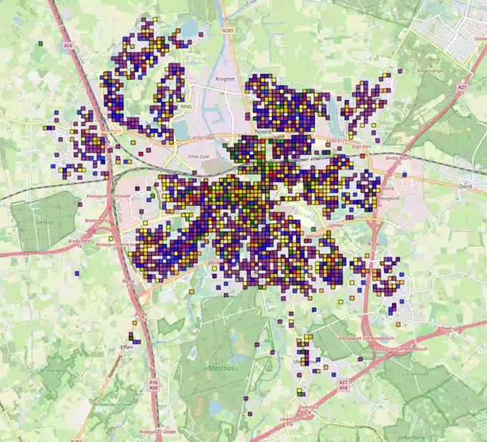
EDA Results
Afval: blue
Zwervers: green
Drugs/alcohol: red
Jeugd: orange
Parkeeroverlast: purple
Fietsoverlast: yellow
Wildplassen: grey

Slide 6
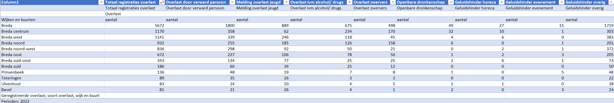
EDA Results

Slide 7
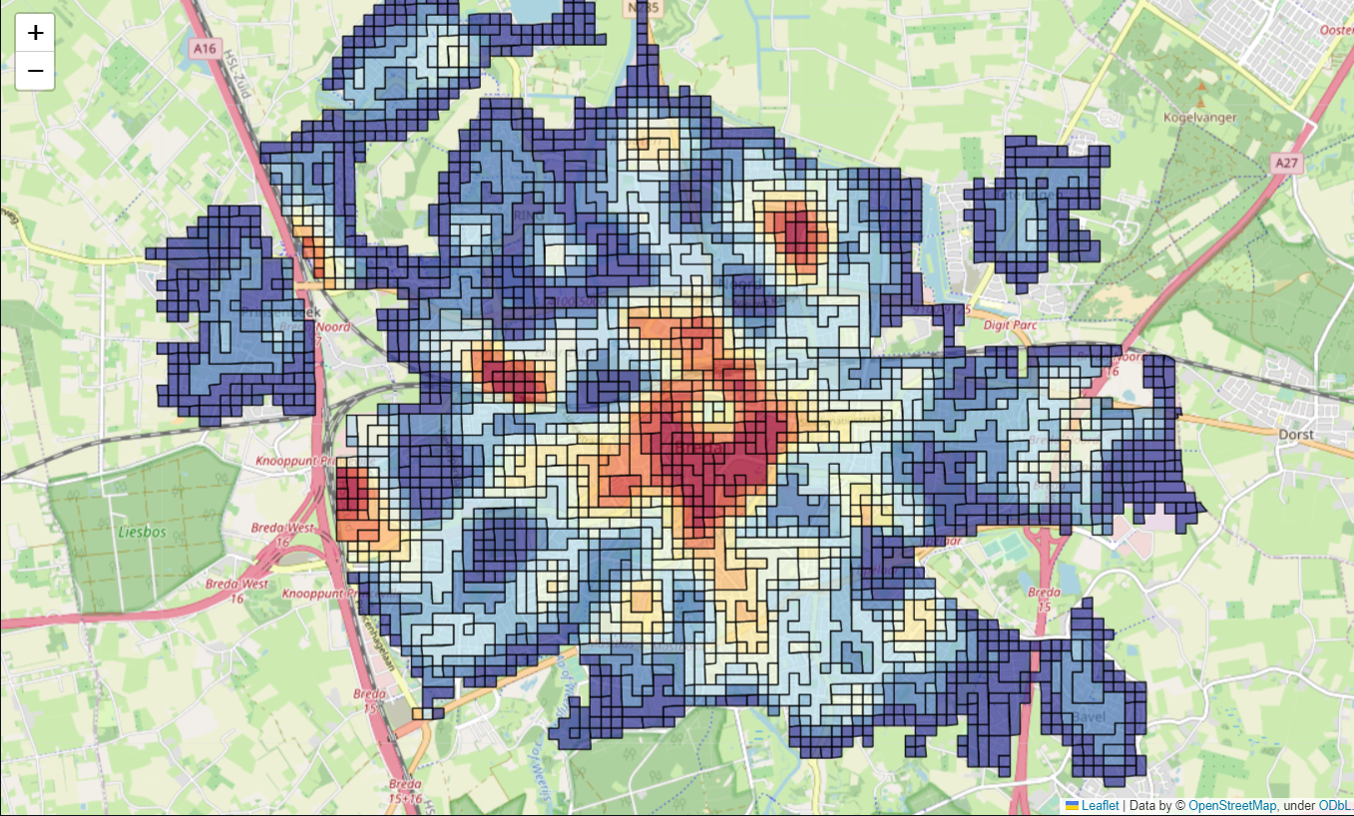
EDA Results
Visualization of neighbourhoods with highest heat indices in Breda

Slide 8
Questions?

